Slide 1

GP VIRTUAL MONITORING SYSTEM
MUHAMMAD MEMON - B00142198
Notes:
© Copyright PresentationGo.com – The free PowerPoint template library

Slide 2
AIM OF THE PROJECT
GP VIRTUAL MONITORING SYSTEM
The GP Virtual Monitoring System utilizes advanced technologies for remote tracking of vital signs.
Integrates sensors including the SEN0203 heart rate sensor, DS18B20 temperature sensor, and Bluetooth blood pressure monitor.
Enables individuals worldwide to monitor heart rate, body temperature, and blood pressure from the comfort of homes and Particularly beneficial for individuals unable to travel.
Improve continuity of care, facilitate early detection of health issues, and empower individuals to manage their health virtually via Online Appointments
Notes:
© Copyright PresentationGo.com – The free PowerPoint template library

Slide 3
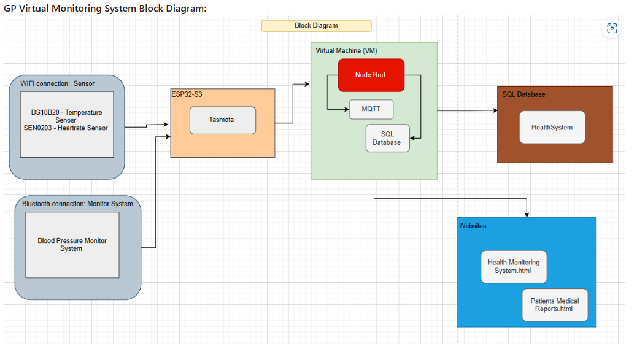
BLOCK DIAGRAM
GP VIRTUAL MONITORING SYSTEM
Notes:
© Copyright PresentationGo.com – The free PowerPoint template library

Slide 4
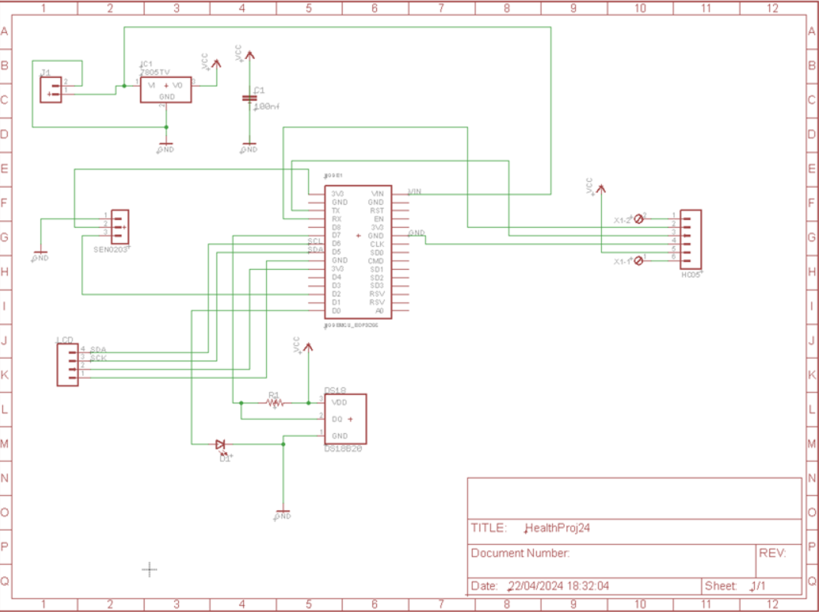
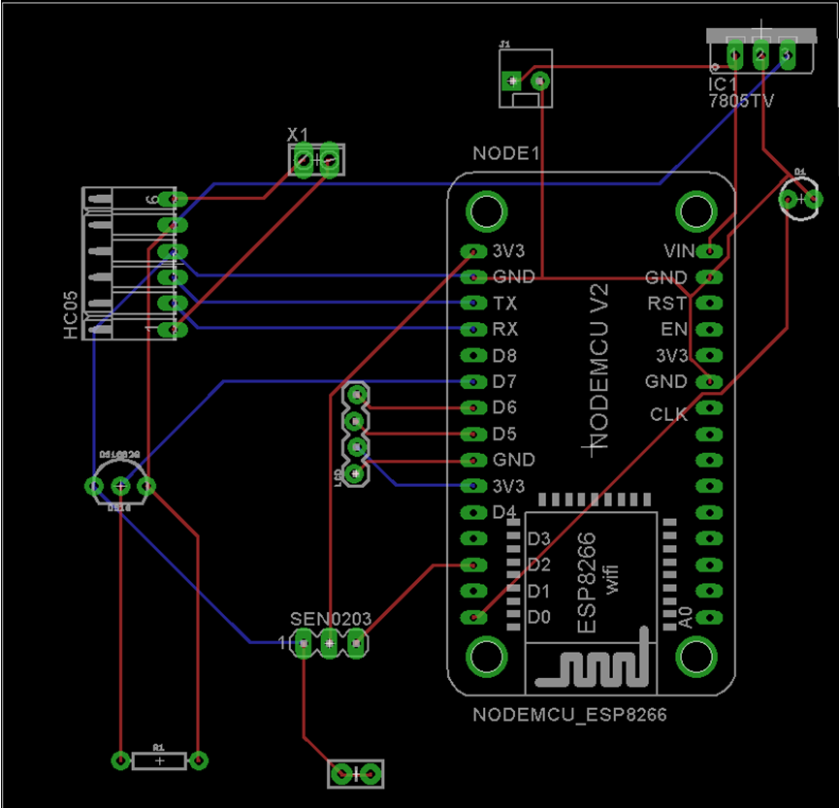
PCB HARDWARE DESIGN
GP VIRTUAL MONITORING SYSTEM
Notes:
© Copyright PresentationGo.com – The free PowerPoint template library

Slide 5
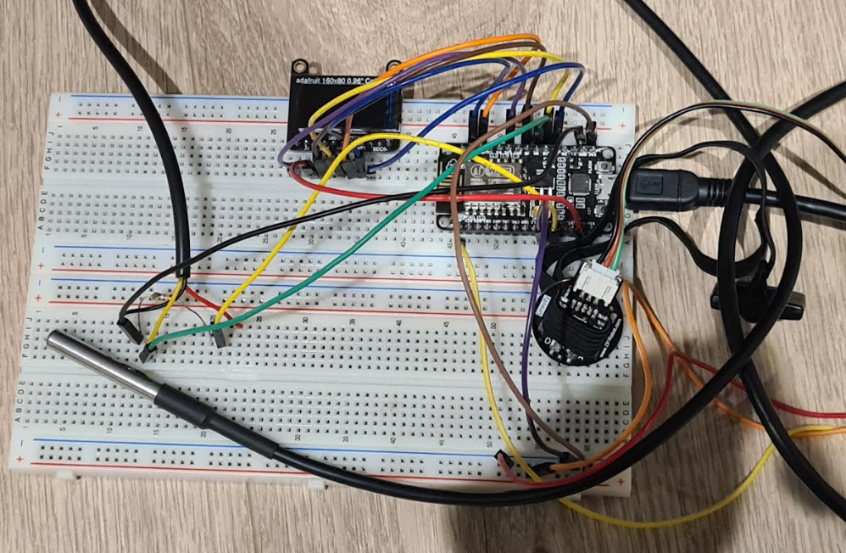
BREADBOARD HARDWARE DESIGN
GP VIRTUAL MONITORING SYSTEM
Notes:
© Copyright PresentationGo.com – The free PowerPoint template library

Slide 6
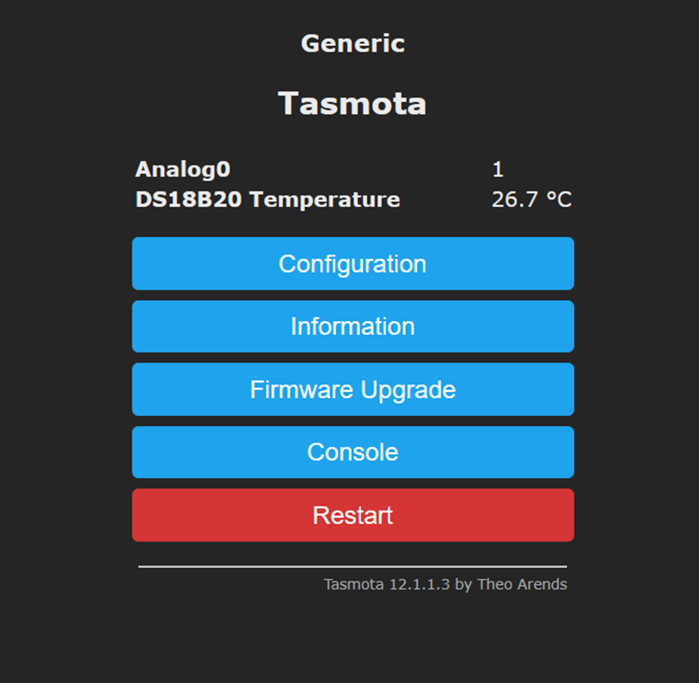
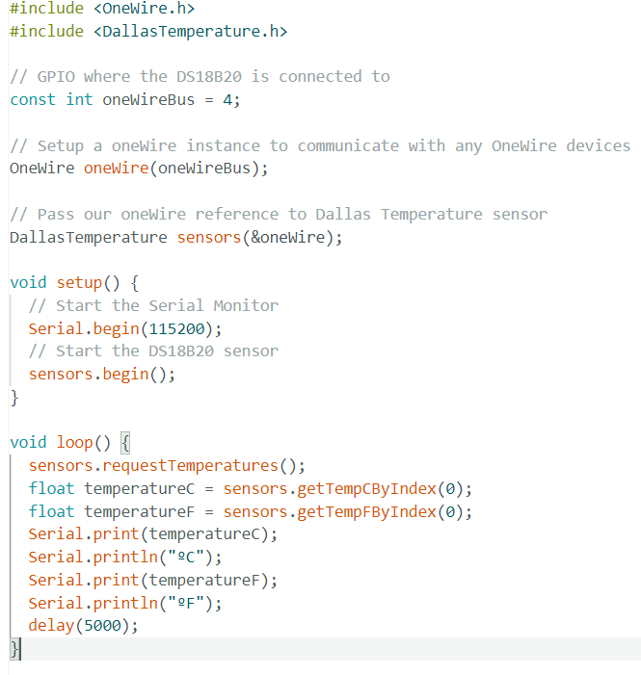
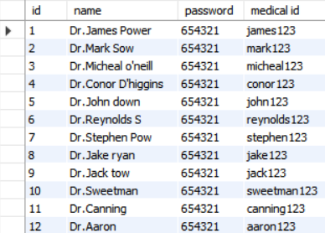
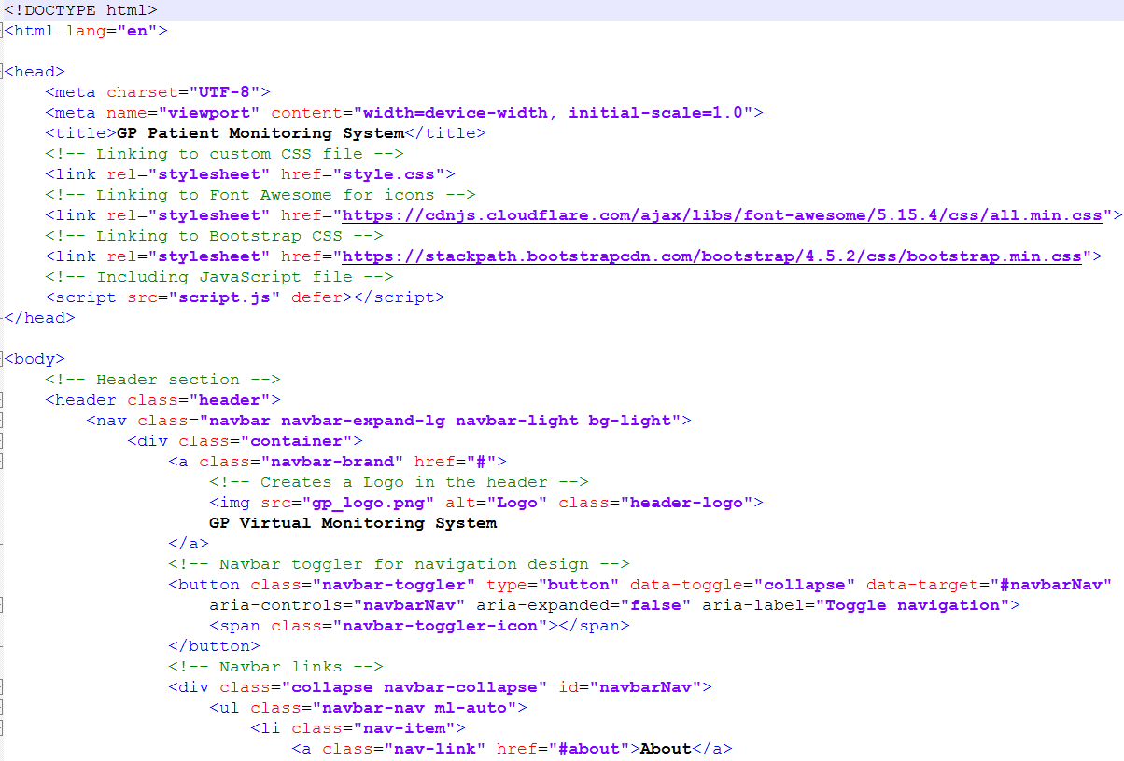
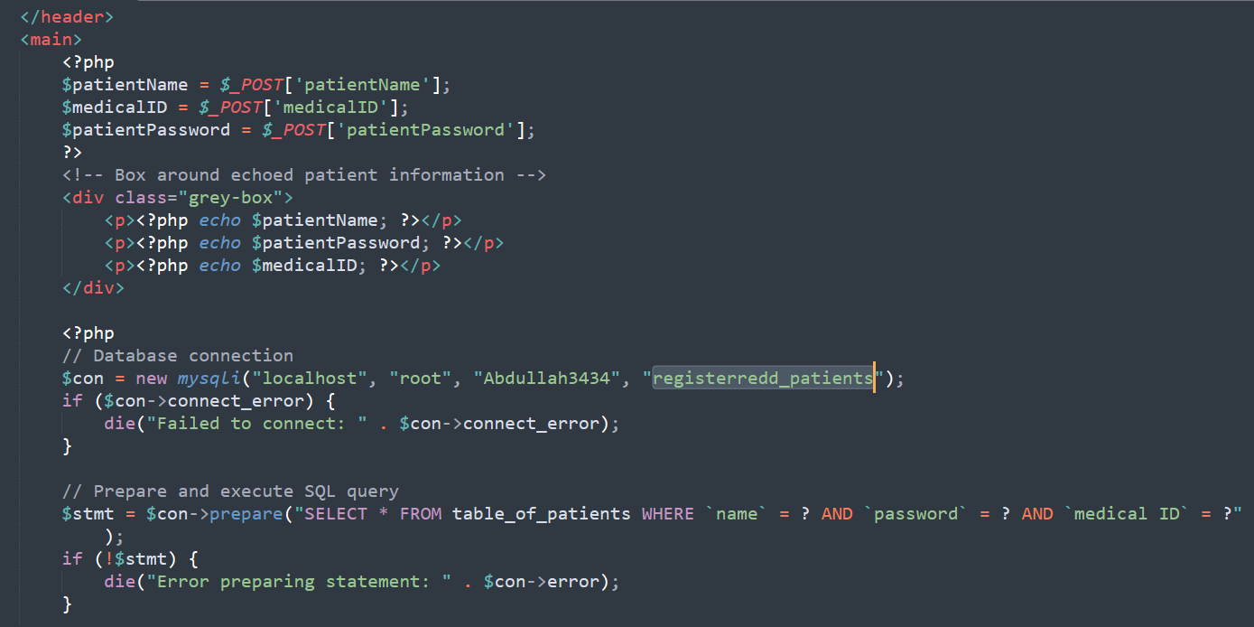
SOFTWARE DESIGN
GP VIRTUAL MONITORING SYSTEM
Tasmota Ardunio SQL Databases Notepad++
Eagle
Sublime TextPad
Notes:
© Copyright PresentationGo.com – The free PowerPoint template library

Slide 7


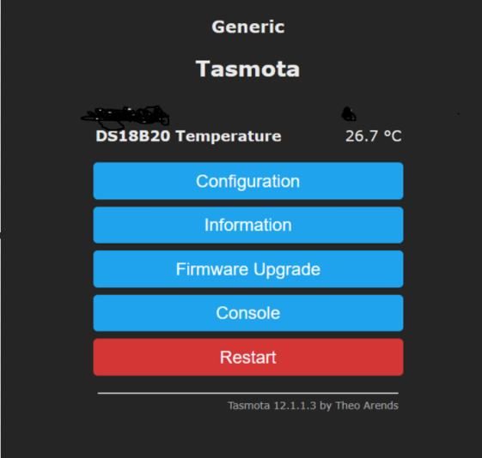
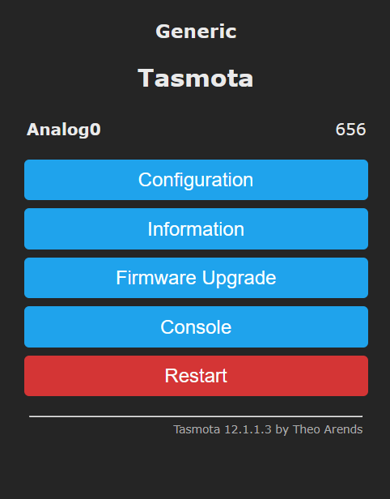
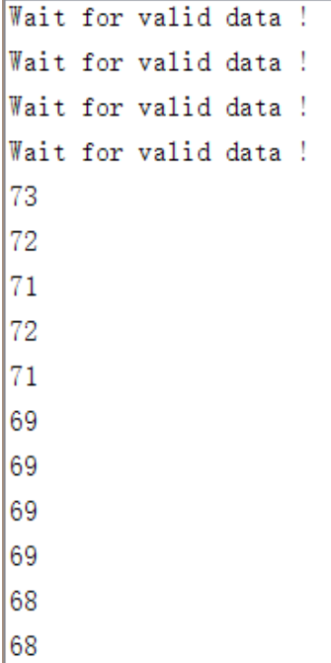
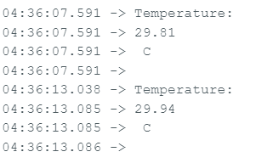
SENSORS TESTING
GP VIRTUAL MONITORING SYSTEM
DS18B20 Tasmota Test
SEN0203 Tasmota Test
SEN0203 Arduino Test
DS18B20 Arduino Test
Notes:
© Copyright PresentationGo.com – The free PowerPoint template library

Slide 8
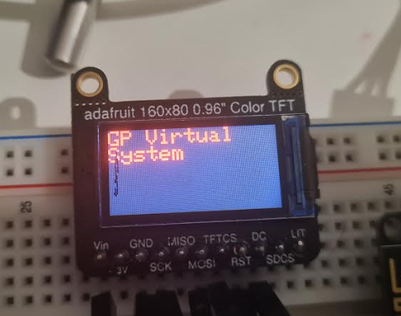
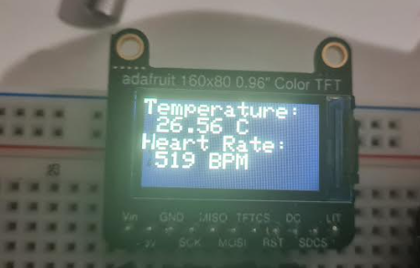
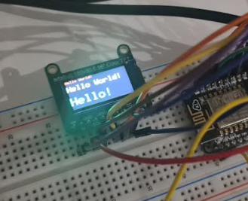
ADAFRUIT SCREEN TESTING
GP VIRTUAL MONITORING SYSTEM
Adafruit Screen Test
Step 2: Connected sensors to the screen
Step 1: To get Hello World
Notes:
© Copyright PresentationGo.com – The free PowerPoint template library

Slide 9
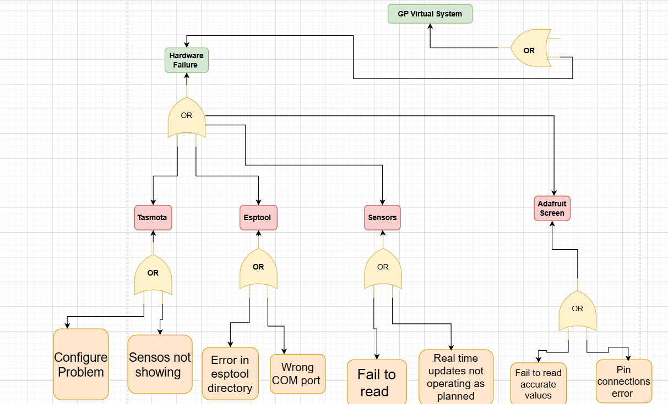
HARDWARE DESIGN FAULT TREE
GP VIRTUAL MONITORING SYSTEM
Notes:
© Copyright PresentationGo.com – The free PowerPoint template library

Slide 10
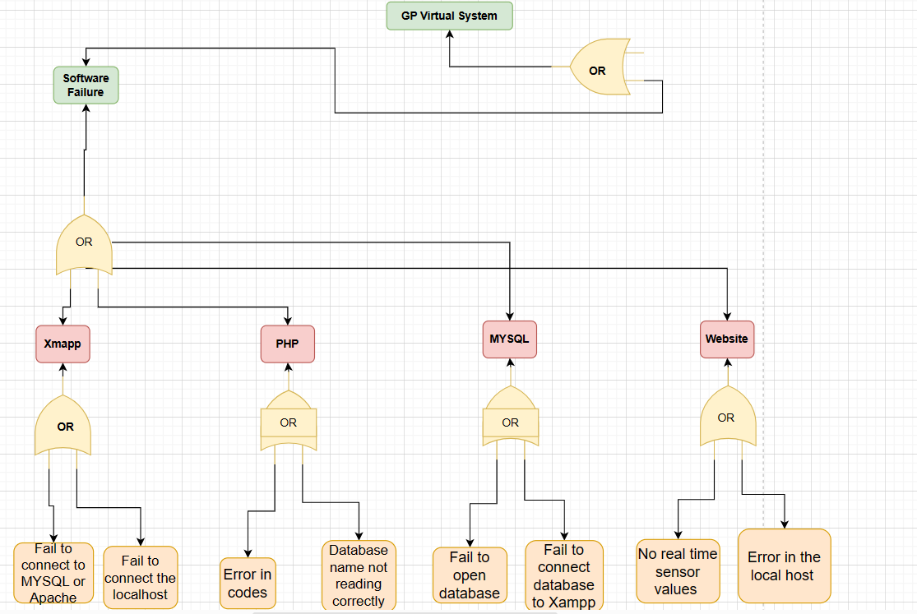
SOFTWARE DESIGN FAULT TREE
GP VIRTUAL MONITORING SYSTEM
Notes:
© Copyright PresentationGo.com – The free PowerPoint template library

Slide 11
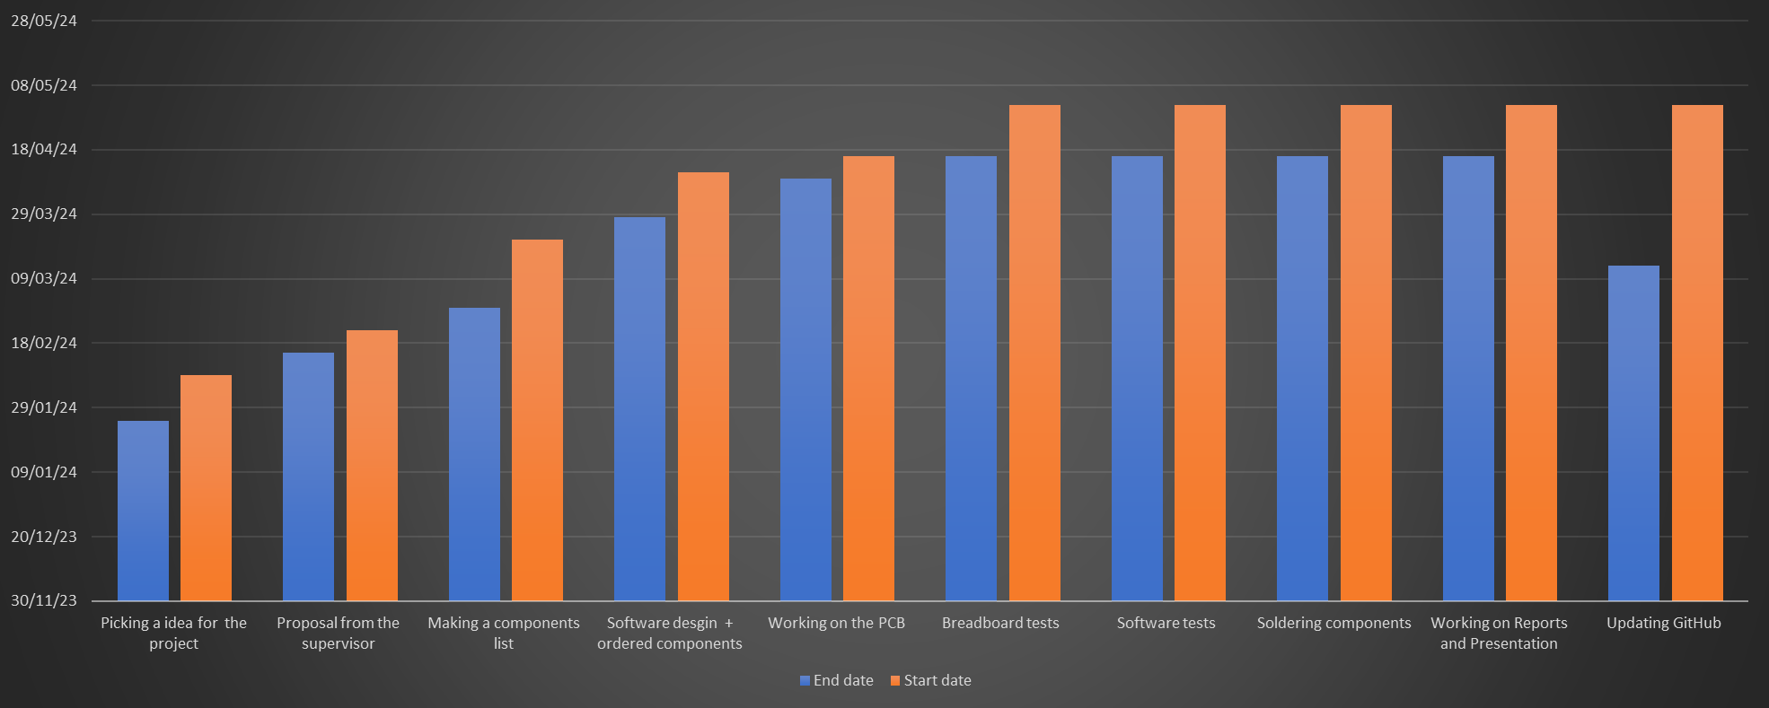
TIMELINE OF THE PROJECT
GP VIRTUAL MONITORING SYSTEM
Notes:
© Copyright PresentationGo.com – The free PowerPoint template library

Slide 12
THANK YOU FOR LISTENING
ANY
QUESTIONS?

